Slide 1
L1088 Environmental Economics
Richard S.J. Tol

Slide 2
EnvEcon 0 - Origins
This module
State of the environment
History of environmental and resource economics

Slide 3
0 Introduction
1 Social choice
2 Externalities and public goods
3 Decision analysis
4 Valuation: Aims and purpose
5 Valuation: Revealed preferences
6 Valuation: Stated preferences
7 Direct regulation
8 Market-based instruments
9 Complications with instruments
10 Growth and the environment
11 Green accounting

Slide 4
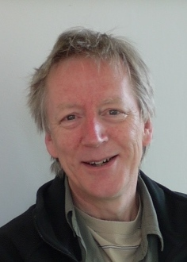
A very short introduction
A free market will not deliver environmental quality
Environmental economics is about
the desired environmental quality and
the best way of delivering that
It is a framework for thinking about trade-offs
Zero pollution is not desirable
Command and control rarely works
Market-based instruments protect the environment at lower cost
Tradable permits are one example
A broad view of what matters to people
Climate policy requires coordinated international action
Climate policy requires a transformation of the energy sector

Slide 5
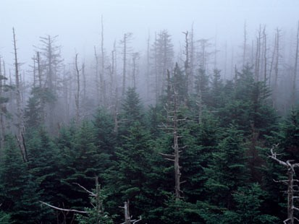
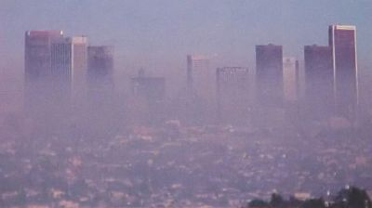
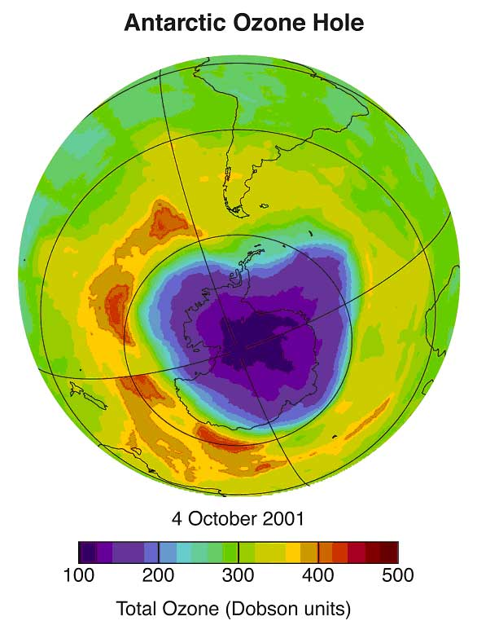
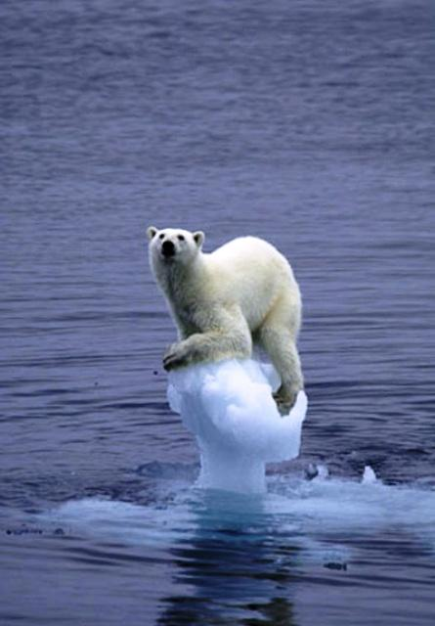
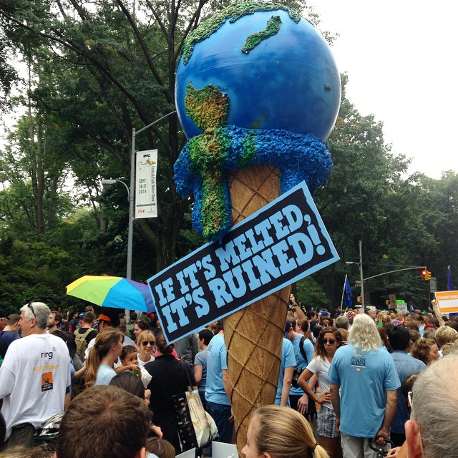

Slide 6
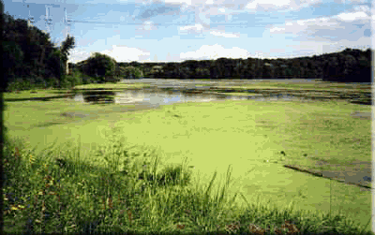
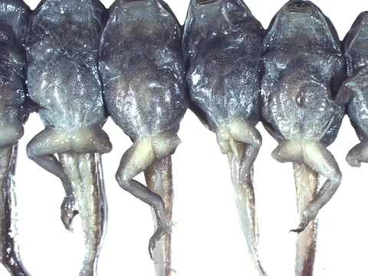
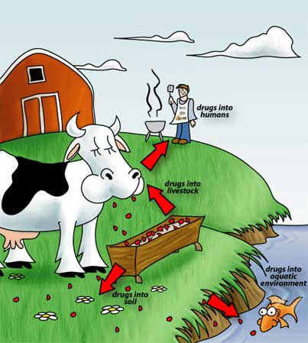
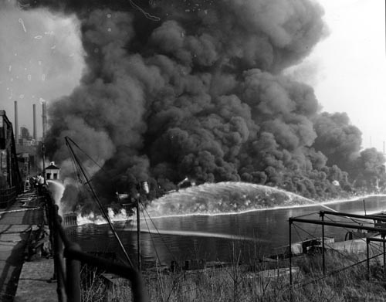

Slide 7
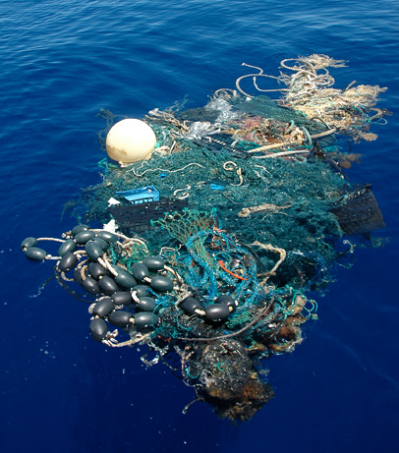
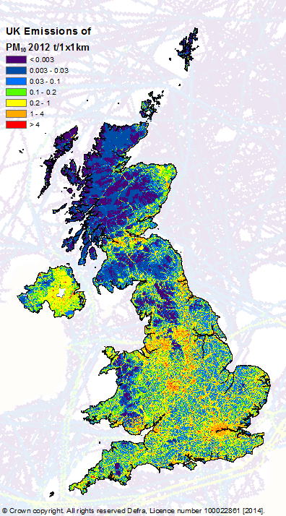
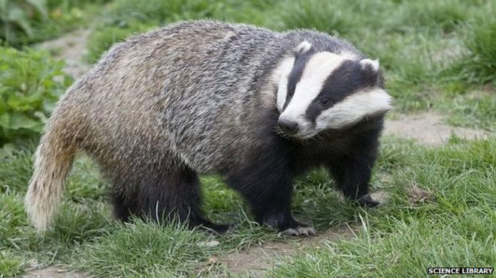
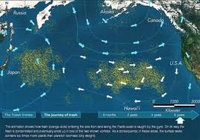

Slide 8
The Emergence of Environmental and Resource Economics
Proto-economics
Classical economics
Neo-classical economics, Keynes and the Modern Synthesis
Environmental economics

Slide 9
The Emergence of Environmental and Resource Economics
Proto-economics
Classical economics
Neo-classical economics, Keynes and the Modern Synthesis
Environmental economics

Slide 10
Proto-Economics
Early economists wrote mostly about agriculture, farm management, and crop prices
That’s what the economy was about then
They were keenly aware of the importance of the natural environment
Physiocrats even made land the anchor point in their theory of value
Typically thought that the human condition was primarily shaped by climate and geography

Slide 11
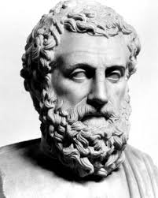
Aristotle
“[t]hose who live in a cold climate and in Europe are full of spirit, but wanting in intelligence and skill [...] and are incapable of ruling over others […] [w]hereas the natives of Asia are intelligent and inventive, but they are wanting in spirit, and therefore they are always in a state of subjection and slavery.”

Slide 12
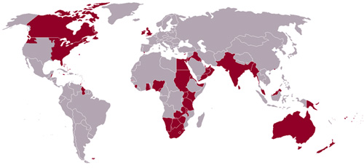
Aristotle
“[t]hose who live in a cold climate and in Europe are full of spirit, but wanting in intelligence and skill [...] and are incapable of ruling over others […] [w]hereas the natives of Asia are intelligent and inventive, but they are wanting in spirit, and therefore they are always in a state of subjection and slavery.”

Slide 13
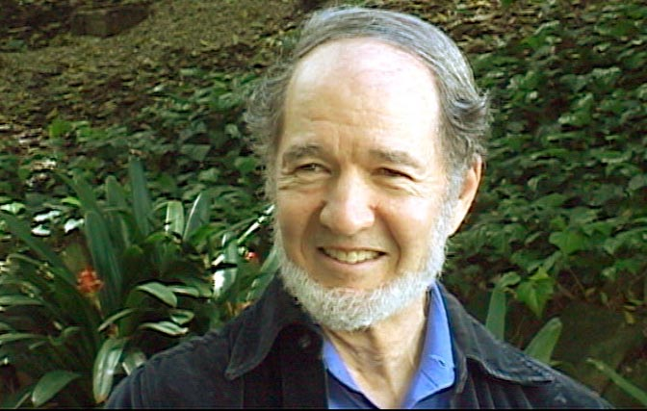
Proto-Economics
Early economists wrote mostly about agriculture, farm management, and crop prices
That’s what the economy was about then
They were keenly aware of the importance of the natural environment
Typically thought that the human condition was primarily shaped by climate and geography
Geographical determinism continues to today

Slide 14
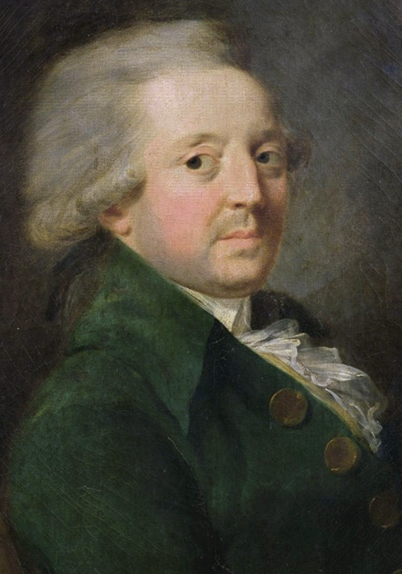
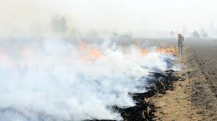
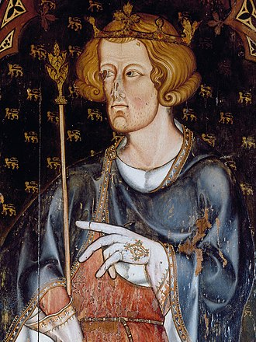
Proto-Economics
Condorcet (1776) agricultural activity by corrupting the air, causes illnesses in neighbouring homes
King Edward I had earlier (1273, 1306) banned coal burning in London

Slide 15
The Emergence of Environmental and Resource Economics
Proto-economics
Classical economics
Neo-classical economics, Keynes and the Modern Synthesis
Environmental economics

Slide 16
Classical Economics
Classical economists were convinced that, in the long run, resource constraints would stop economic expansion
No more growth
If the population would continue to grow, economic output per capita would shrink

Slide 17
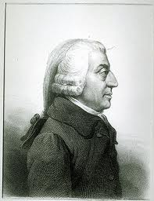
Classical Economics
Adam Smith
Invisible hand of general equilibrium
Social good by individual action
Nightwatch state
Except for … erecting and maintaining certain publick works and certain public institutions … because the profit would never repay the expence to any individual, … though it may frequently do much more than repay it to a great society

Slide 18
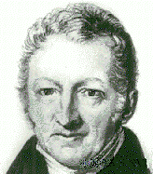
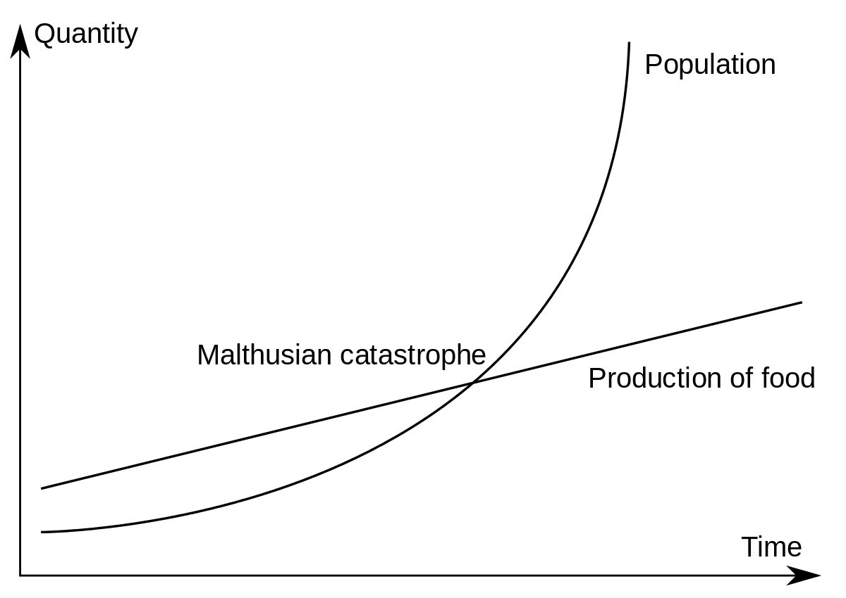
Classical Economics
Thomas Malthus: growing population, diminishing returns to scale in agriculture

Slide 19
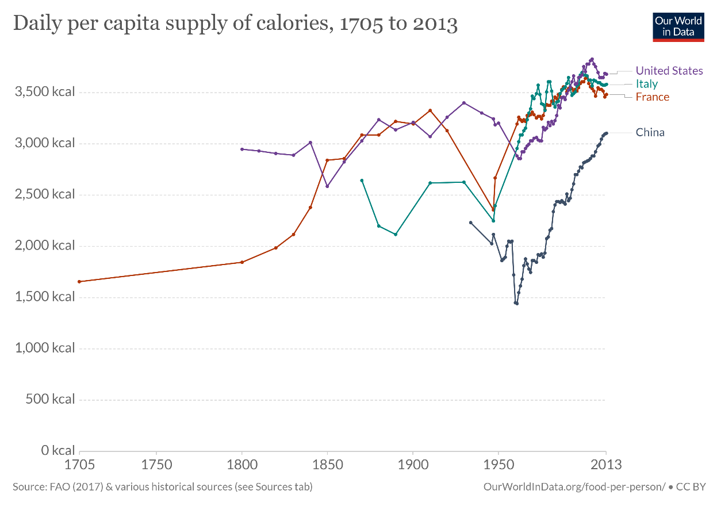
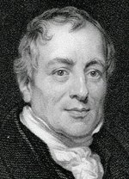
Classical Economics
David Ricardo agreed with Malthus, but distinguished between diminishing returns to scale (intensive margin), diminishing quality (extensive margin)
Like all Classical economists, Ricardo believed that economic growth would end

Slide 20
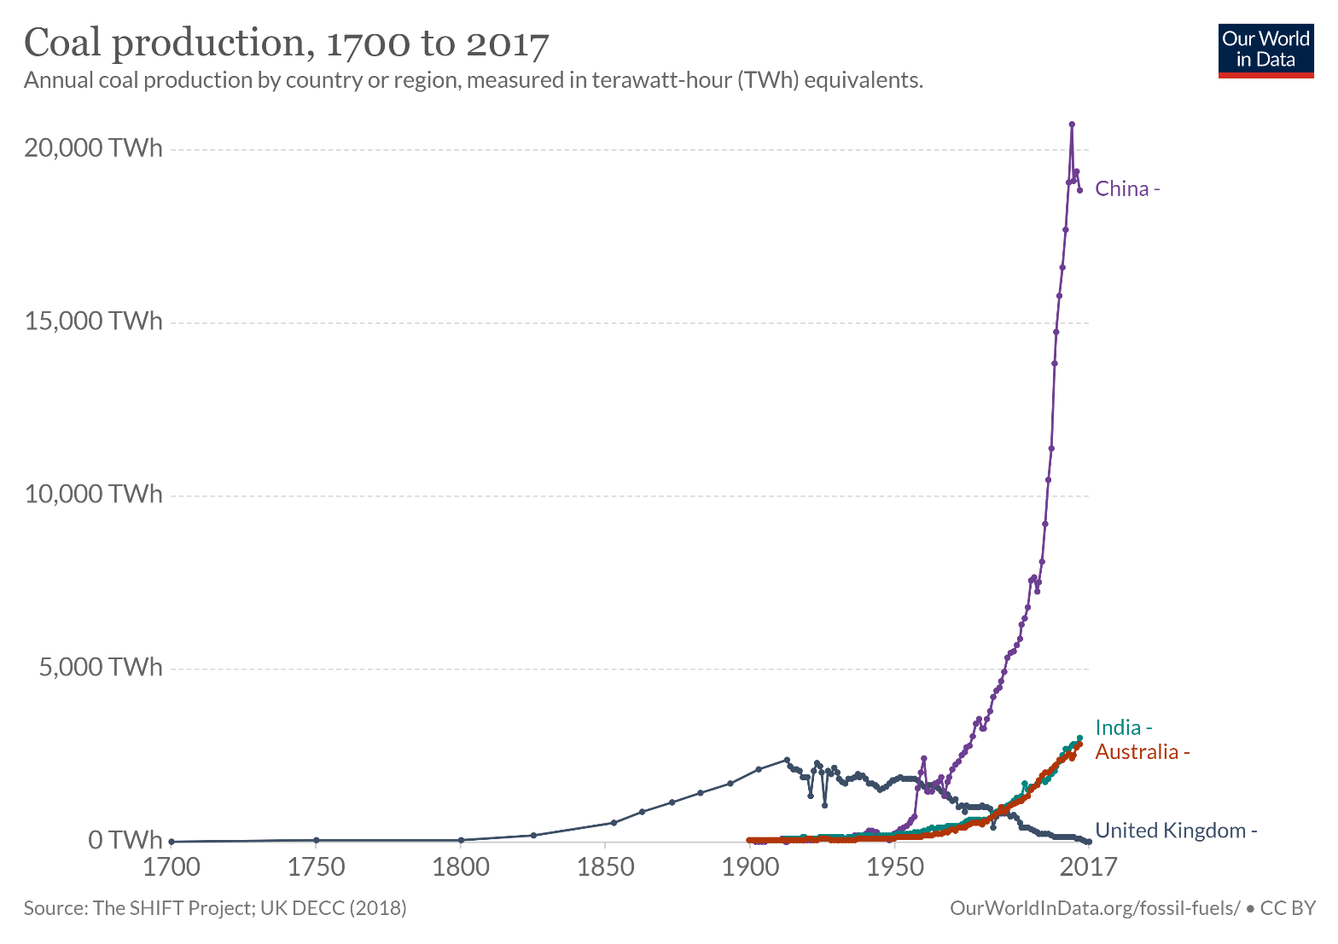
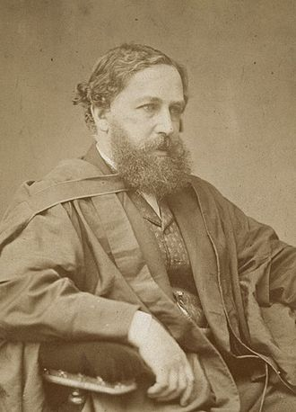
“I must point out the painful fact that such a rate of growth will before long render our consumption of coal comparable with the total supply. In the increasing depth and difficulty of coal mining we shall meet that vague, but inevitable boundary that will stop our progress.”
W.S. Jevons
1865

Slide 21
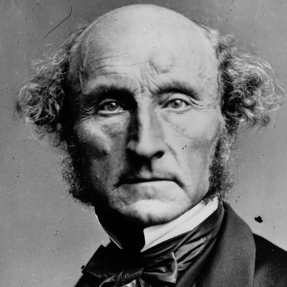
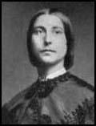
Classical Economics
John Stuart Mill (1857) agreed with Malthus and Ricardo, but tempered with innovation and input substitution
Amenity value “it is only in backward countries of the world that increased production is still an important object[ive]”

Slide 22

Classical Economics -2
Mill (1857): “There is room in world, no doubt, for a great increase in population, supposing the arts of life to go on improving, and capital to increase. [...] The density of population necessary to obtain all of the advantages both of cooperation and of social intercourse [...] has been attained. A population may be too crowded, though all be amply supplied with food and raiment. [...] Nor is there much satisfaction in contemplating the world with nothing left to the spontaneous activity of nature.”

Slide 23
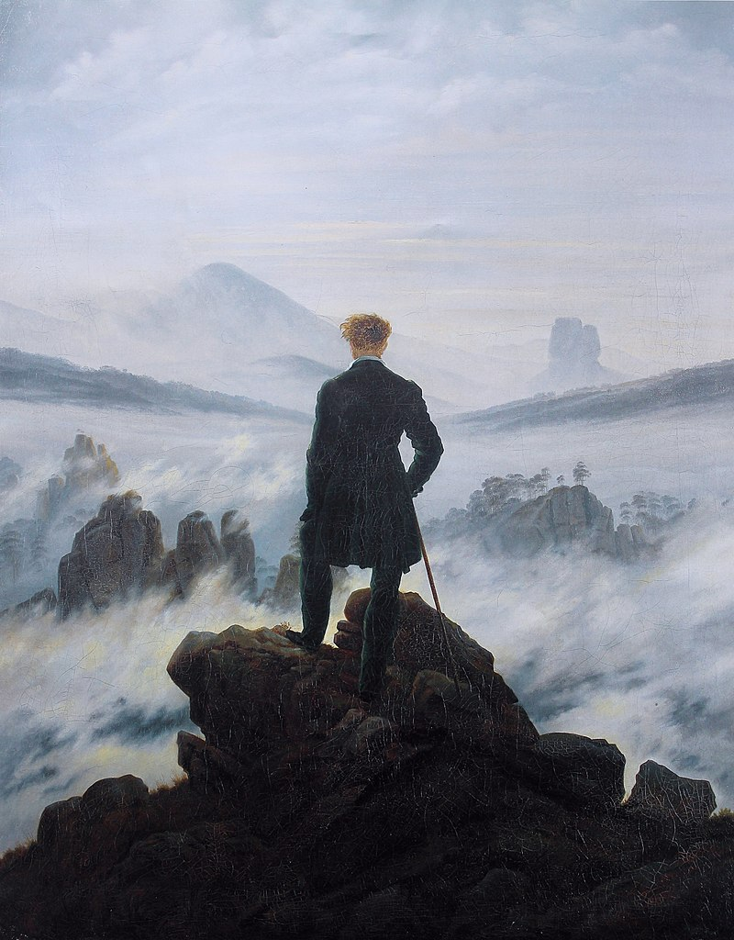
Romanticism vs Enligthenment
1770-1850
Emotions vs reasons
Beautiful vs dangerous nature
Harking for a simpler past
Three successors
Communism
Nazism & fascism
Naturalism & Environmentalism

Slide 24
The Emergence of Environmental and Resource Economics
Proto-economics
Classical economics
Neo-classical economics, Keynes and the Modern Synthesis
Environmental economics

Slide 25
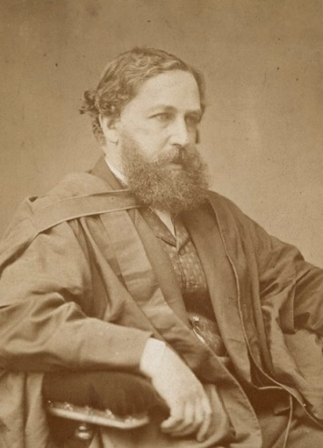
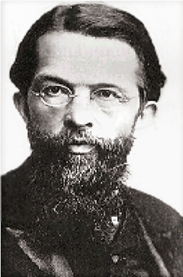
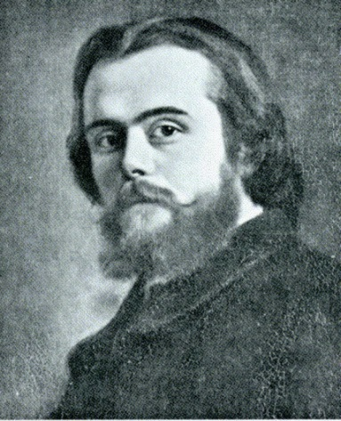
Neo-Classical Economics
Value is relative, determined in exchange, reflecting preferences, production costs and scarcity
Earlier theories of value were absolute, prices set by God, land, or labour
Demand and supply, partial and general equilibrium
Absolute scarcity no longer seen as a problem, a reflection of the times
Push into Africa, India, American West
Rapid technological progress
Rapid industrialization

Slide 26
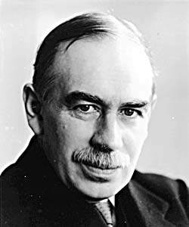
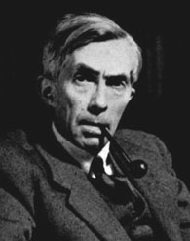
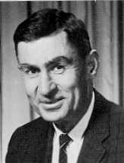
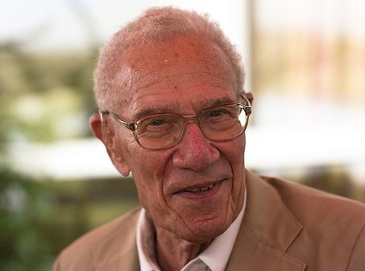
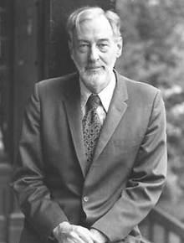
Keynesian and Modern Economics
Keynes’ macro-economics indirectly reinvoked interest in economic growth
Early growth models: no resource limits

Slide 27
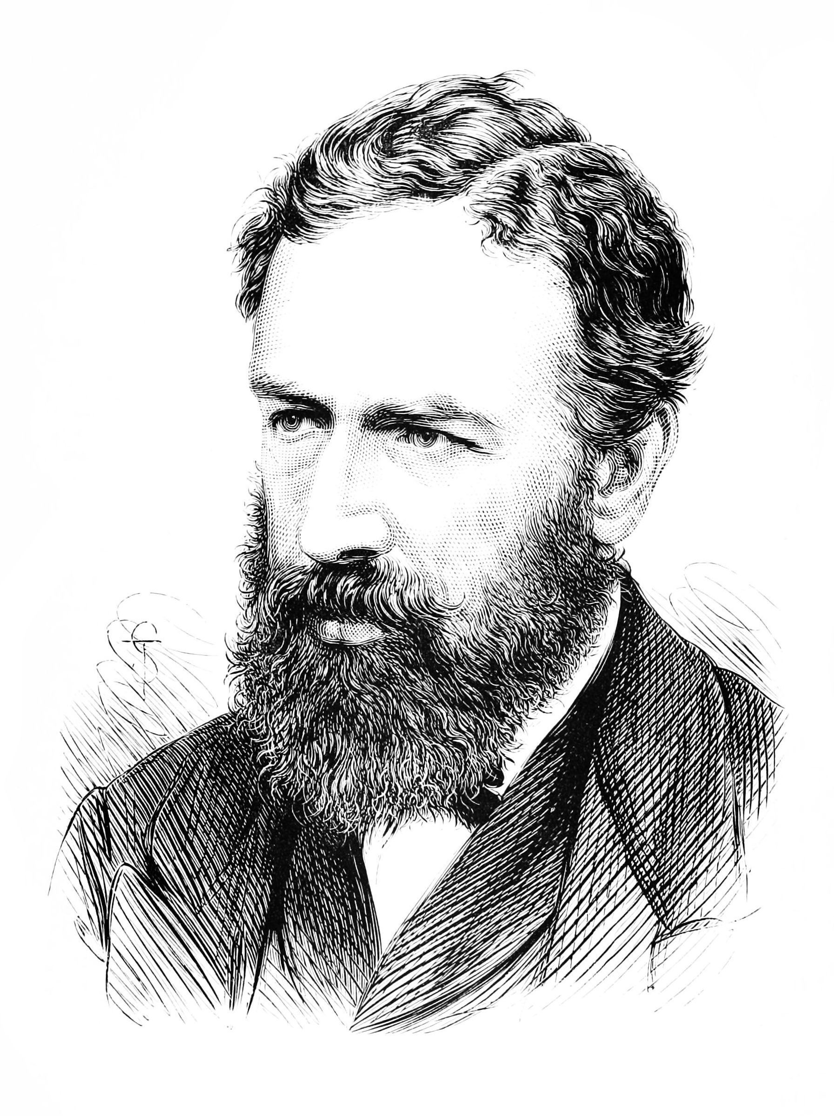
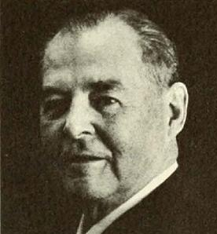
Precursors
Early growth models: no resource limits
Jevons (1865) anticipated that we will eventually run out of coal
Noted, but not influential
Hotelling (1931) worked on the economics of exhaustible resources
Largely ignored until the 1970s

Slide 28
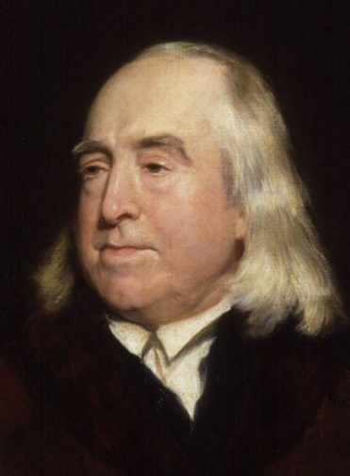
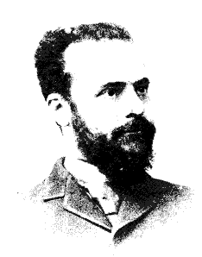
Welfare Economics
Rigorous theory of social good
Utilitarianism: Social good is the (weighted) sum of individual good
Pareto superiority: At least as good for all, better for one
Aristotle: A voluntary exchange is Pareto superior
Smith / Lerner / Hotelling: A free market is Pareto optimal
Actual and potential Pareto optimality (after transfers)

Slide 29
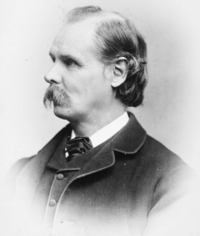
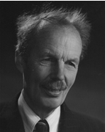
Welfare Economics
Marshall: Externalities – if there are unintended and uncompensated consequences of one agent to the next, then market transactions need not be Pareto improving
Pigou: Taxes can counteract this
Marshall also worked on overexploitation of common property
Many of the core themes of environmental and resource economics go back to the early days

Slide 30
The Emergence of Environmental and Resource Economics
Proto-economics
Classical economics
Neo-classical economics, Keynes and the Modern Synthesis
Environmental economics

Slide 31
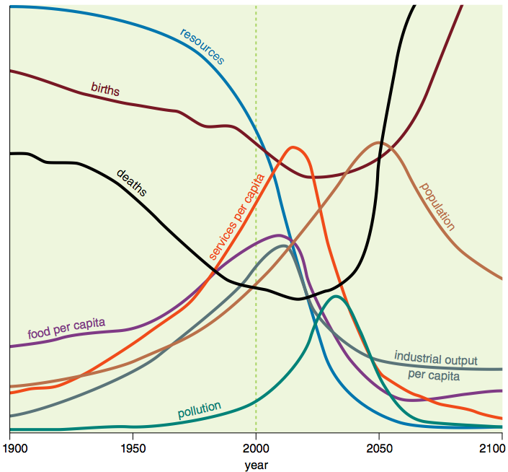
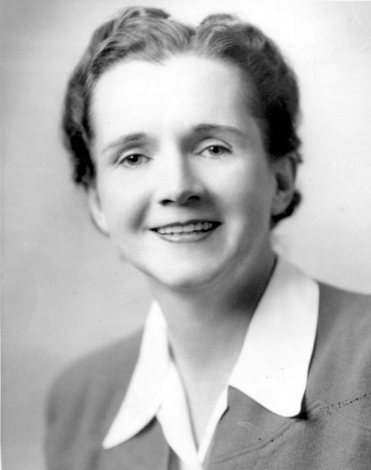
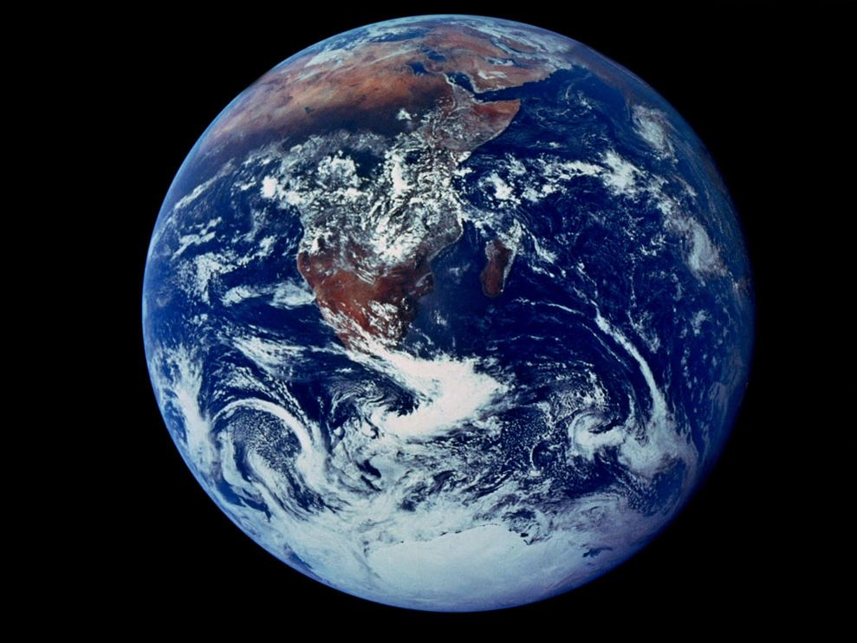
Environmental & Resource Economics
In the 1960s and 70s, things changed: Limits to Growth, Silent Spring, oil crisis, pollution, space travel, congestion

Slide 32
Environmental & Resource Economics
Things changed in the 1960s and 70s
Natural resources are scarce
Environmental services are valuable
There are substantial environmental externalities

Slide 33
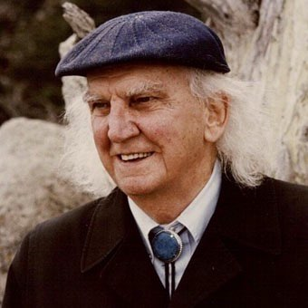
Environmental & Resource Economics
Kenneth Boulding
Anyone who believes exponential growth can go on forever in a finite world is either a madman or an economist
Return to Classical economics
Rees and Wackernagel’s ecological footprint echoes the Physiocrat land theory of value.

Slide 34
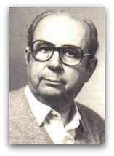
Environmental & Resource Economics
Nicholas Georgescu-Roegen
economics gives no signs of acknowledging the role of natural resources in the economic process … the product of the economic process is waste, waste is an inevitable result of that process and ceteris paribus increases in greater proportion than the intensity of economic activity
Models of the economy as a part of the natural environment

Slide 35
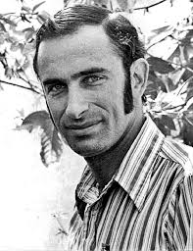

Ehrlich v Simon
"Sometime in the next fifteen years, the end will come. And by 'the end' I mean an utter breakdown of the capacity of the planet to support humanity." (Ehrlich, 1970)
Paul R. Ehrlich is a biologist, key figure in Club of Rome
Julian L. Simon, an economist, took issue
Wager that prices of copper, chromium, nickel, tin and tungsten would go up (Ehrlich) or down (Simon)
Simon won
Ultimate resource is human ingenuity

Slide 36
Environmental & Resource Economics
Environmental economics is the dominant (orthodox) school of thought, in the tradition of Pigou and Simon
Environmental problems can be corrected at the margin
New economics (post Dixit-Stiglitz) has had little impact on environmental economics
Causal inference has only recently made inroads
Ecological economics is a heterodox school of thought, in the tradition of Malthus and Boulding
Environmental problems require systemic change

Slide 37















Slide 38
Environmental & Resource Economics
Environmental and resource economics has now become a respectable field
Many US & UK universities offer an education programme
There are specialised journals, including REEP, JAERE, JEEM, REE, ERE, EPA, LE while general journals and conferences have regular sessions on environmental and resource economics
Leading economists like Acemoglu, Arrow, Baumol, Bradford, Jorgenson, Nordhaus, Sachs, Schelling, Solow, Stiglitz
And we got the Nobel Prize

